Slide 1
三维游戏引擎的技术与实现
2012级数字媒体技术2班
201218242435
武云潇
指导老师：何军

Slide 2
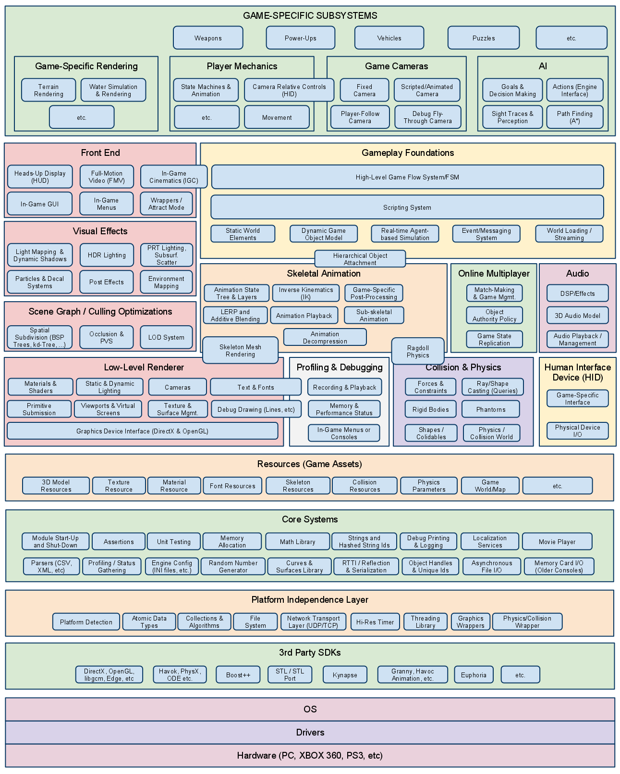
游戏 = 引擎 + 内容
基于Direct3D 9，在win32平台下开发
中低层渲染系统
主要涉及 动画系统
碰撞检测系统
学术研究 & 实用价值
技术演示 & 游戏原型

Slide 3
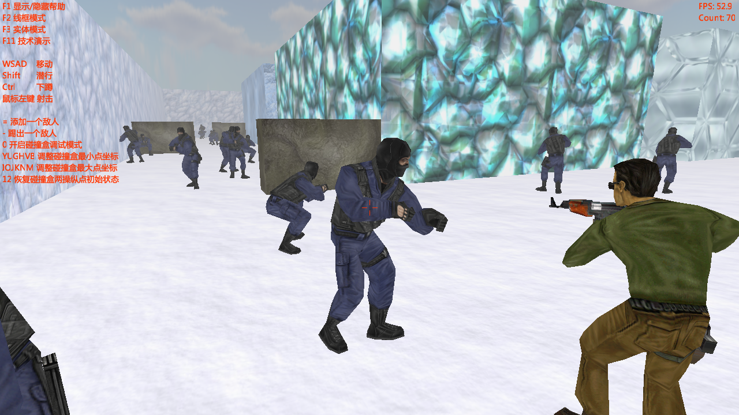
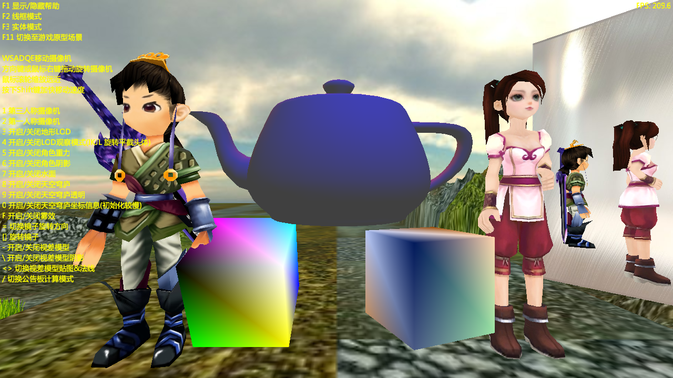

Slide 4
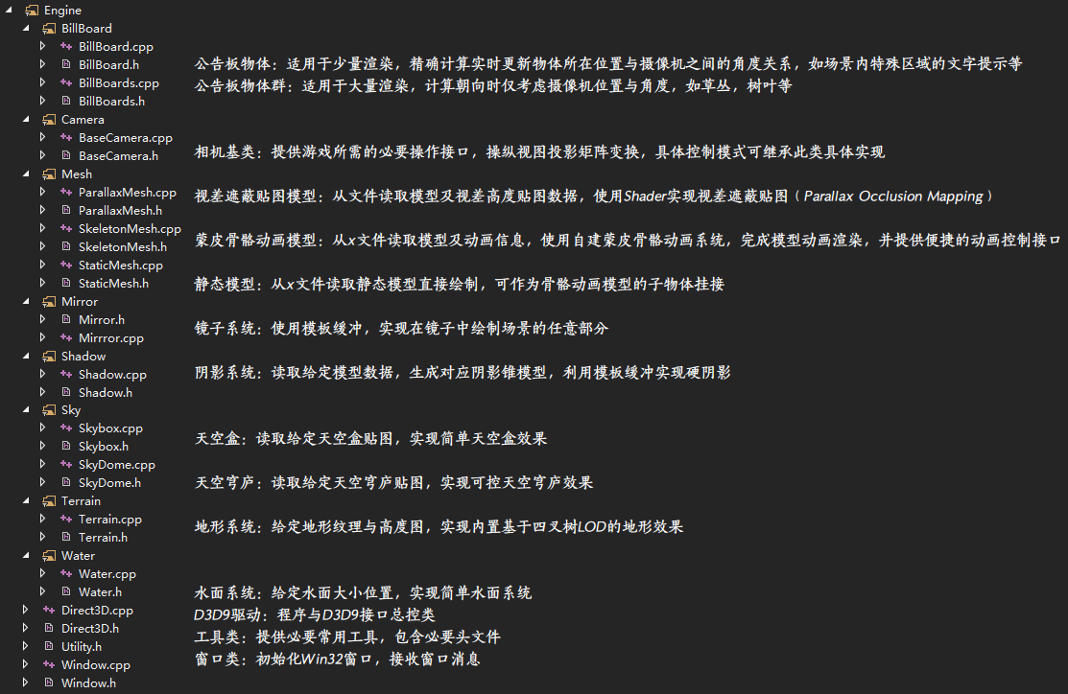
引擎核心技术点
公告板技术
视差贴图模型与自阴影
蒙皮骨骼动画系统
阴影锥
地形LOD
射线碰撞检测系统

Slide 5
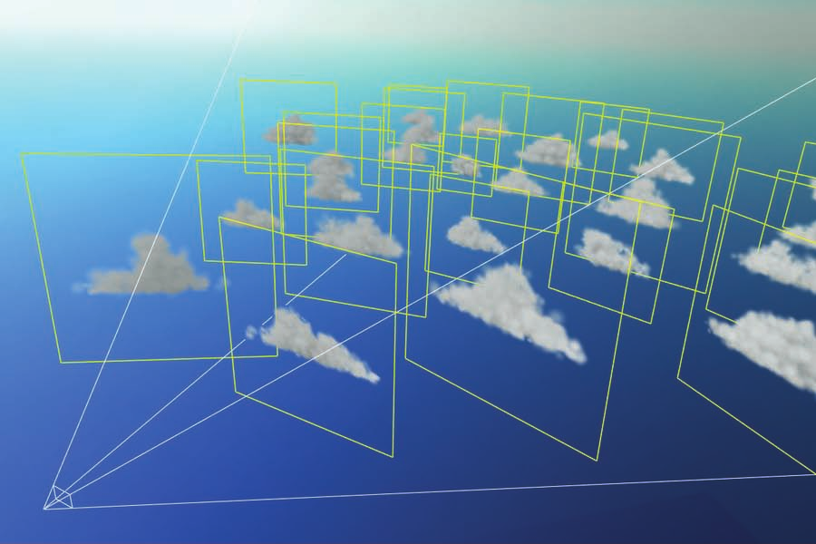
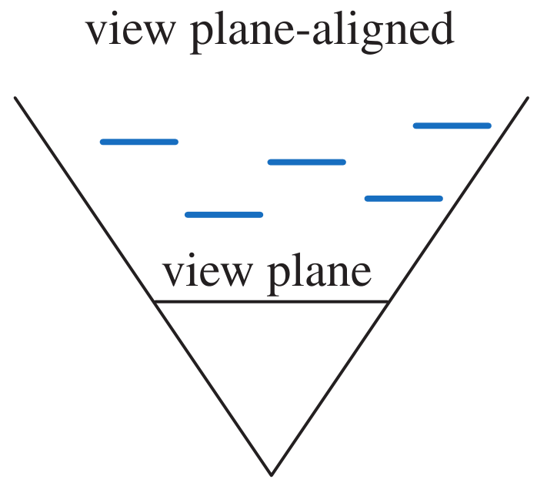
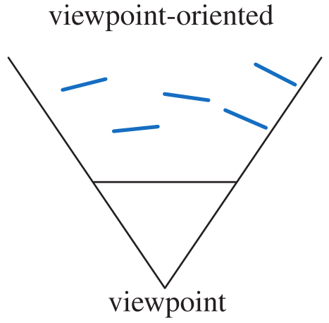
公告板技术
面向视点的公告板
视平面对齐的公告板
矩阵变换
Notes:
根据渲染数量分为……

Slide 6
面向视点的公告板
D3DXVECTOR3 vUp(mView._12, mView._22, mView._32);
/* simpler, yet supposed-to-be less efficient *
D3DXMatrixLookAtRH(&m_matWorld, &m_vPos, &vPos, &vUp); // Backward Direction
m_matWorld._41 = m_matWorld._42 = m_matWorld._43 = 0.0f;
D3DXMatrixTranspose(&m_matWorld, &m_matWorld);
/* optimized by doing manually */
D3DXVECTOR3 zaxis(m_vPos - vPos); D3DXVec3Normalize(&zaxis, &zaxis);
D3DXVECTOR3 xaxis; D3DXVec3Normalize(D3DXVec3Cross(&xaxis, &vUp, &zaxis), &xaxis);
D3DXVECTOR3 yaxis; D3DXVec3Cross(&yaxis, &zaxis, &xaxis);
m_matWorld._11 = xaxis.x; m_matWorld._12 = xaxis.y; m_matWorld._13 = xaxis.z;
m_matWorld._21 = yaxis.x; m_matWorld._22 = yaxis.y; m_matWorld._23 = yaxis.z;
m_matWorld._31 = zaxis.x; m_matWorld._32 = zaxis.y; m_matWorld._33 = zaxis.z;
/**/
m_matWorld._41 = m_vPos.x; m_matWorld._42 = m_vPos.y; m_matWorld._43 = m_vPos.z;
CDirect3D::getInstance()->SetTransform(D3DTS_WORLD, &m_matWorld);
CDirect3D::getInstance()->DrawPrimitive(D3DPT_TRIANGLESTRIP, 0, 2);

Slide 7
视平面对齐的公告板
m_matWorld = mView;
m_matWorld._12 = m_matWorld._32 = m_matWorld._41 = m_matWorld._42 = m_matWorld._43 = 0.f;
m_matWorld._22 = 1.f;
D3DXMatrixTranspose(&m_matWorld, &m_matWorld);
for (unsigned int i(0); i < m_vPos.size(); i++) {
m_matWorld._41 = m_vPos[i].x; m_matWorld._42 = m_vPos[i].y; m_matWorld._43 = m_vPos[i].z;
CDirect3D::getInstance()->SetTransform(D3DTS_WORLD, &m_matWorld);
CDirect3D::getInstance()->DrawPrimitive(D3DPT_TRIANGLESTRIP, 0, 2);
}

Slide 8
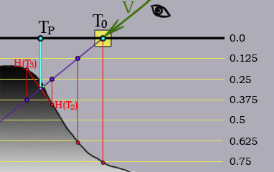
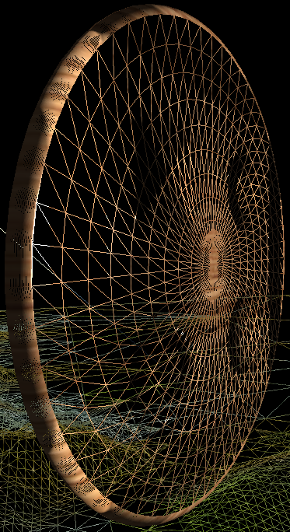
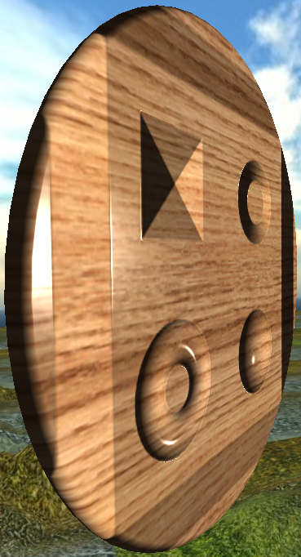
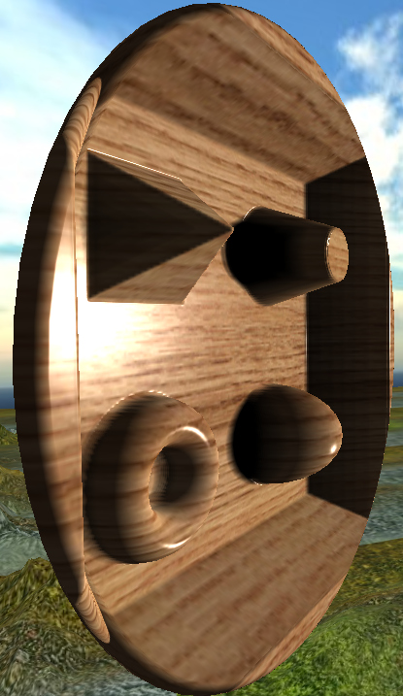
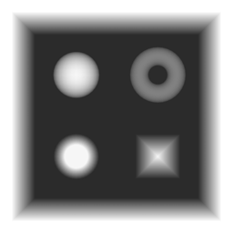
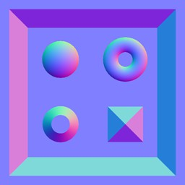
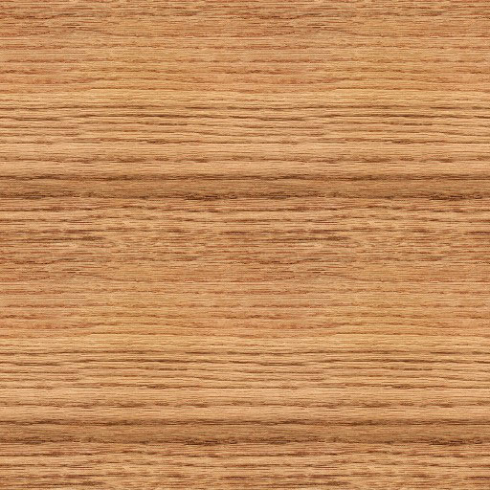
视差贴图(Parallax occlusion mapping)模型 与自阴影
Shader Programming (HLSL)
光照模型
法线贴图
Tricky Mathematics

Slide 9
视差遮蔽贴图(Parallax occlusion mapping)
// Steep Parallax Mapping
while (iCnt < iTotal) {
vCur -= vStep; // Vt反向延长线
fCurH = tex2Dlod(spNH, float4(vCur, 0, 1)).a;
fCur -= fStep;
if (fCurH > fCur) {
cur = float2(fCur, fCurH);
prev = float2(fCur + fStep, fPrevH);
fPrevH = fCurH;
iCnt = iTotal;
} else {
fPrevH = fCurH;
iCnt++;
}
}
// POM interpolation
float fPrevDelta = prev.x - prev.y; // Positive
float fCurDelta = cur.x - cur.y; // Negative
float fWeight = fCurDelta / (fPrevDelta - fCurDelta);
float2 uv = vCur - vStep * fWeight;

Slide 10
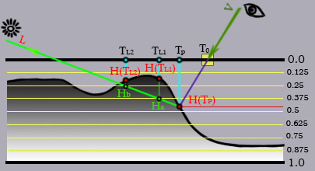
软自阴影
// Soft Self-Shadowing
float fShadowFactor = 1;
if (g_bShadows && Lt.z > 0) {
float fTemp = 0;
iTotal = lerp(20, 4, Lt.z);
iCnt = 1;
fCur = tex2Dlod(spNH, float4(uv, 0, 1)).a;
fStep = (1 - fCur) / iTotal;
vStep = fStep * Lt.xy * g_fDepth;
vCur = uv;
while (iCnt < iTotal) {
vCur += vStep; // Lt延长线
fCurH = tex2Dlod(spNH, float4(vCur, 0, 1)).a;
fCur += fStep;
fTemp = max((fCurH - fCur) * (1- iCnt / iTotal) * 5, fTemp);
iCnt++;
}
fShadowFactor = 1 - fTemp;
}
o.color = ComputeIllumination(uv, Lt, Vt, fShadowFactor);
return o;

Slide 11
光照模型与法线贴图
float4 ComputeIllumination(float2 uv, float3 Lt, float3 Vt, float fShadowFactor) {
float3 Nt = normalize(tex2D(spNH, uv).rgb * 2 - 1);
float4 color = tex2D(sp, uv);
float4 cDiffuse = saturate(dot(Lt, Nt)) * g_cDiffuse;
/* Phong Reflection Model *
float3 Rt = normalize(2 * dot(Lt, Nt) * Nt - Lt);
float fRdotV = saturate(dot(Rt, Vt));
float4 cSpecular = saturate(pow(fRdotV, g_fSpecularExponent)) * g_cSpecular;
/* Blinn-Phong Reflection Model */
float3 Ht = normalize(Lt + Vt);
float fNdotH = saturate(dot(Nt, Ht));
float4 cSpecular = saturate(pow(fNdotH, g_fSpecularExponent)) * g_cSpecular;
/**/
return ((g_cAmbient + cDiffuse) * color + cSpecular) * fShadowFactor;
}

Slide 12
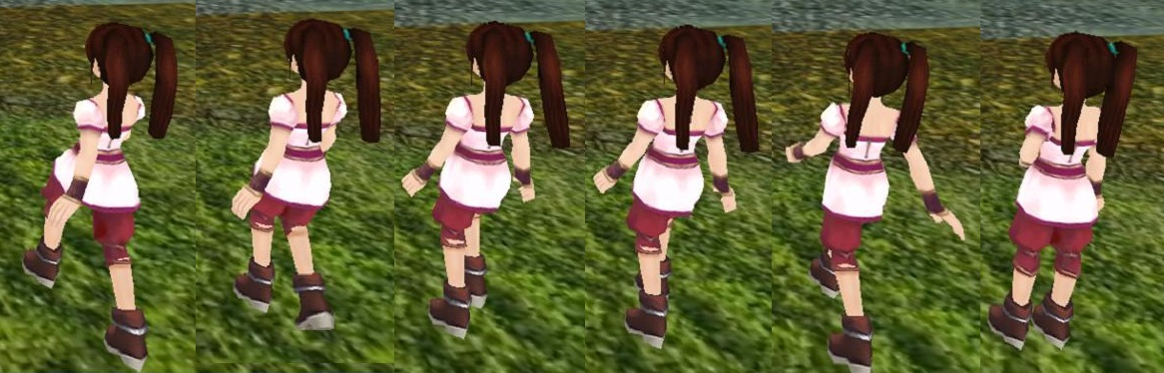
蒙皮骨骼动画系统
struct AnimationVectorKey { float fTime; D3DXVECTOR3 vecKey; };
struct AnimationQuaternionKey { float fTime; D3DXQUATERNION quatKey; };
struct AnimationMatrixKey { float fTime; D3DXMATRIX matKey; };
// 动画
struct Animation {
char FrameName[MAX_CHAR];
SkinMeshFrame* pFrame;
std::vector<AnimationVectorKey> vecScaleKeys;
std::vector<AnimationQuaternionKey> vecQuatKeys;
std::vector<AnimationVectorKey> vecTranslationKeys;
std::vector<AnimationMatrixKey> vecMatKeys;
};
// 动画集
struct AnimationSet {
char AnimSetName[MAX_CHAR];// 动画名称
float fAnimationLength;// 动画长度
std::vector<Animation*> vecAnimations;
};
// 骨骼
struct SkinMeshFrame {
char strFrameName[MAX_CHAR];
D3DXMATRIX matLocalMatrix;// 本地骨骼变换矩阵
D3DXMATRIX matFinalMatrix;// 继承父矩阵骨骼变换矩阵
std::vector<SkinMeshFrame*> vecChildFrame;// 子骨骼
};
// 蒙皮
struct SkinMeshContainer {
char strSkinMeshName[MAX_CHAR];
ID3DXSkinInfo *pSkinInfo;// 蒙皮信息
ID3DXMesh *pOriginalMesh;// 初始蒙皮
ID3DXMesh *pRenderMesh;// 当前渲染蒙皮
std::vector<D3DXMATRIX*> vecMatFrames;// 指向骨骼矩阵
D3DXMATRIX *pBoneMatrices;// 当前帧渲染骨骼矩阵
};
复杂文件解析
复杂矩阵变换
复杂树形结构
Notes:
繁琐

Slide 13
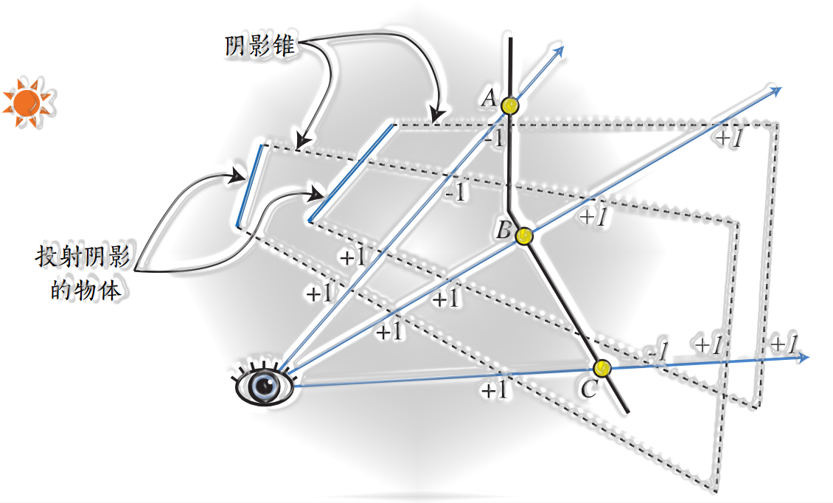
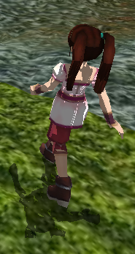
阴影锥
模板缓冲
轮廓搜寻

Slide 14
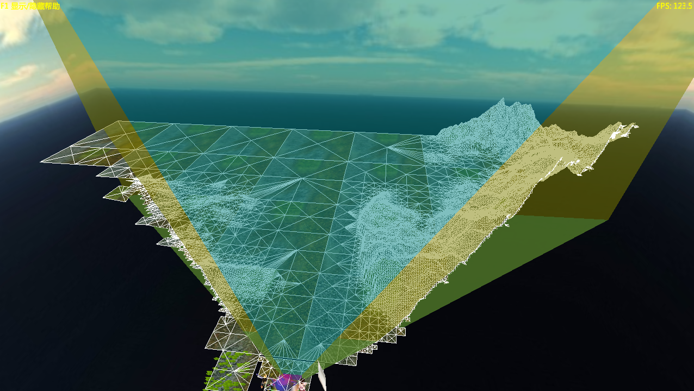
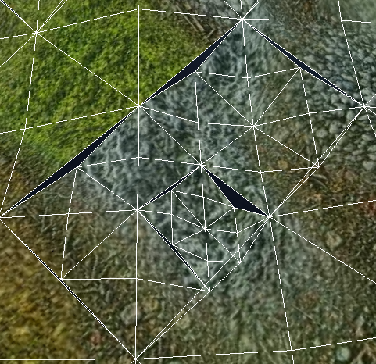
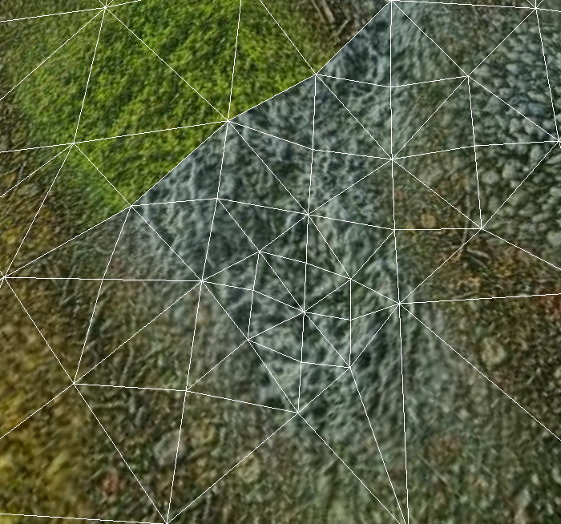
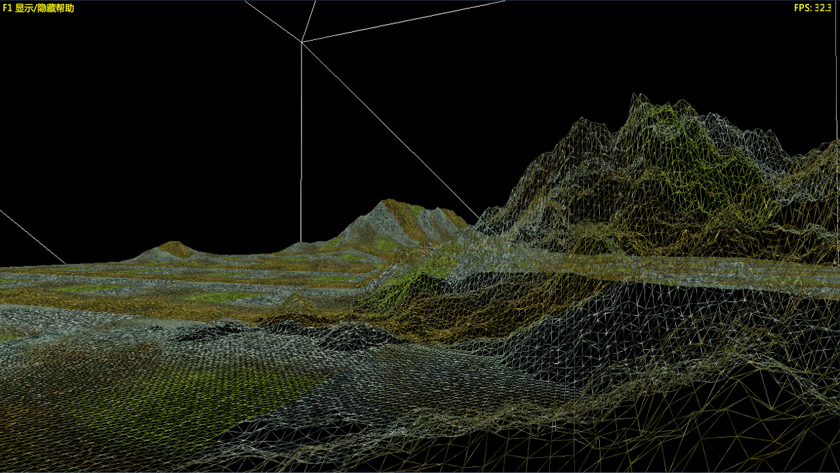
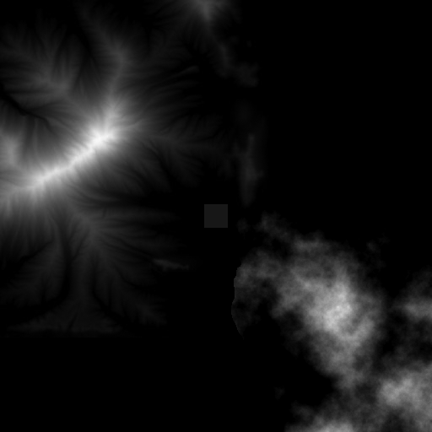
地形LOD
void CTerrain::PruneQuadTree(SNode *node, const D3DXVECTOR3& vPos) {
D3DXVECTOR3 *vCenter = &m_pVertices[node->b + node->H][node->l + node->W];
float fRadiusSq(node->H * m_fSegZ + node->W * m_fSegX);
fRadiusSq *= fRadiusSq;
if (DistanceToFrustumSq(&m_pVertices[node->b][node->l]) > fRadiusSq &&
DistanceToFrustumSq(&m_pVertices[node->b][node->r]) > fRadiusSq &&
DistanceToFrustumSq(&m_pVertices[node->t][node->l]) > fRadiusSq &&
DistanceToFrustumSq(&m_pVertices[node->t][node->r]) > fRadiusSq)
return; // Cull
if (!node->H && !node->W || D3DXVec3LengthSq(&(vPos - *vCenter))
>= node->diff * node->diff * 1e5f) { // Draw
node->status = ERS_VISIBLE;
} else { // Recurse
node->status = ERS_RECURSED;
if (node->nw) PruneQuadTree(node->nw, vPos);
if (node->ne) PruneQuadTree(node->ne, vPos);
if (node->sw) PruneQuadTree(node->sw, vPos);
if (node->se) PruneQuadTree(node->se, vPos);
}
}
四叉树
节点编码索引
分割条件阈值
裂缝修补

Slide 15
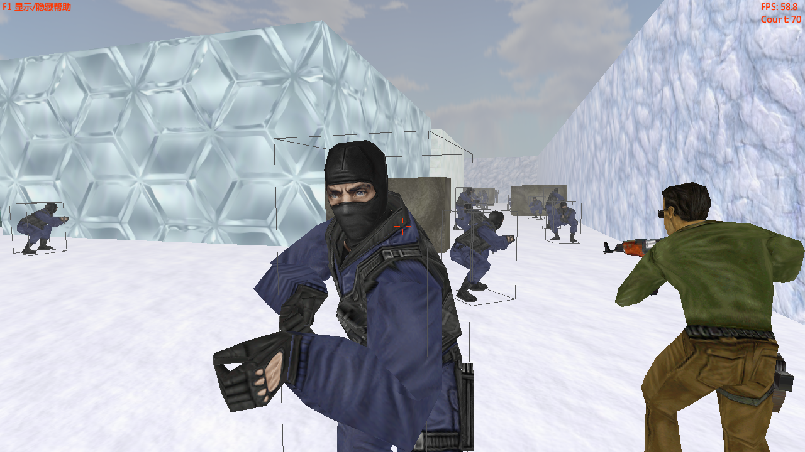
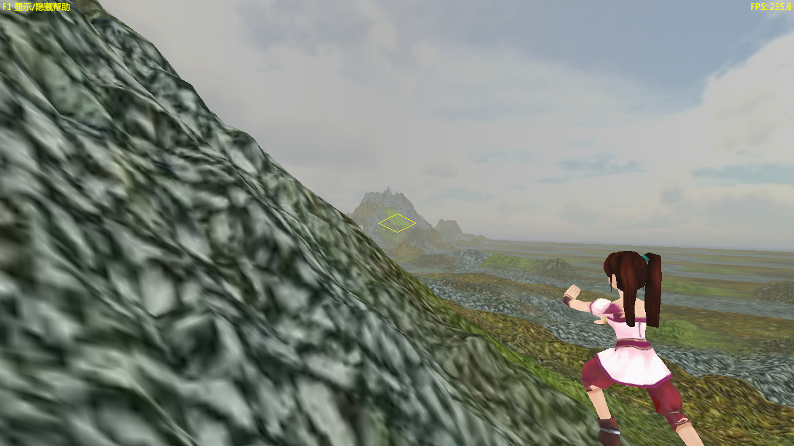
射线碰撞检测系统
Raymarching
Point in triangle
Ray-AABB intersection

Slide 16
Raymarching
const D3DXVECTOR3* CTerrain::Intersect(const D3DXVECTOR3& vPos, const D3DXVECTOR3& vDir) {
float fRow((vPos.z + m_fRZ) / m_fSegZ), fCol((vPos.x + m_fRX) / m_fSegX);
int iRow(static_cast<int>(fRow)), iCol(static_cast<int>(fCol));
const D3DXVECTOR3* vIntersection(NULL);
D3DXVECTOR3 vCheck = vPos;
while (iRow >= 0 && iRow < m_iZ && iCol >= 0 && iCol < m_iX) {
int index = iRow * m_iX * 2 + iCol * 2;
vIntersection = TriangleIntersection(vPos, vDir, m_pNormals[index],
m_pVertices[iRow][iCol], m_pVertices[iRow][iCol+1], m_pVertices[iRow+1][iCol]);
if (vIntersection) return vIntersection;
vIntersection = TriangleIntersection(vPos, vDir, m_pNormals[index+1],
m_pVertices[iRow+1][iCol+1], m_pVertices[iRow][iCol+1], m_pVertices[iRow+1][iCol]);
if (vIntersection) return vIntersection;
// Optimization inspired by Bresenham
bool bX(vDir.x > 0.f), bZ(vDir.z > 0.f);
float fRowMargin(m_pVertices[iRow + bZ][0].z - vPos.z);
float fColMargin(m_pVertices[0][iCol + bX].x - vPos.x);
float fEz(vDir.z / vDir.x * fColMargin);
if (fabsf(fEz) > fabsf(fRowMargin)) bZ ? iRow++ : iRow--;
else bX ? iCol++ : iCol--;
}
return NULL;
}

Slide 17
Point in triangle
const D3DXVECTOR3* CTerrain::TriangleIntersection(const D3DXVECTOR3& vPos,
const D3DXVECTOR3& vDir, const D3DXVECTOR3& n,
const D3DXVECTOR3& p0, const D3DXVECTOR3& p1, const D3DXVECTOR3& p2) {
static D3DXVECTOR3 vIntersection(0.f, .5f, 0.f);
if (D3DXVec3Dot(&vDir, &n) >= 0.f) return NULL;
float fDist = D3DXVec3Dot(&(vPos - p0), &n);
if (fDist < 0.f) return NULL;
fDist /= D3DXVec3Dot(&vDir, &(-n));
vIntersection = vPos + vDir * fDist;
/* side-checking optimal */
float fSign(Sign(p2 - p0, vIntersection - p0, 0)); int axis(0);
if (abs(fSign) < 1e-6) { fSign = Sign(p2 - p0, vIntersection - p0, ++axis);
if (abs(fSign) < 1e-6) fSign = Sign(p2 - p0, vIntersection - p0, ++axis);
} if (Sign(p0 - p1, vIntersection - p1, axis) * fSign < 0) return NULL;
if (Sign(p1 - p2, vIntersection - p2, axis) * fSign < 0) return NULL;
return &vIntersection;
/* side-checking */
D3DXVECTOR3 v0, v1, v2;
D3DXVec3Cross(&v0, &(p2 - p0), &(vIntersection - p0));
D3DXVec3Cross(&v1, &(p0 - p1), &(vIntersection - p1));
D3DXVec3Cross(&v2, &(p1 - p2), &(vIntersection - p2));
if (D3DXVec3Dot(&v0, &v1) > 0 && D3DXVec3Dot(&v1, &v2) > 0) return &vIntersection;
return NULL;
/* barycentric coordinates */
int fD = Determinant(p0, p1, p2) > 0 ? 1 : -1;
float b0 = Determinant(vIntersection, p1, p2) * fD;
float b1 = Determinant(p0, vIntersection, p2) * fD;
float b2 = Determinant(p0, p1, vIntersection) * fD;
if (b1 >= 0 && b2 >= 0 && b0 >= 0) return &vIntersection;
return NULL;
/* brute-force */
D3DXVECTOR3 v0 = p0 - vIntersection;
D3DXVECTOR3 v1 = p1 - vIntersection;
D3DXVECTOR3 v2 = p2 - vIntersection;
D3DXVec3Normalize(&v0, &v0);
D3DXVec3Normalize(&v1, &v1);
D3DXVec3Normalize(&v2, &v2);
float a0 = acosf(D3DXVec3Dot(&v0, &v1));
float a1 = acosf(D3DXVec3Dot(&v0, &v2));
float a2 = acosf(D3DXVec3Dot(&v1, &v2));
if (abs(a0 + a1 + a2 - D3DX_PI * 2.f) < 1e-6)
return &vIntersection;
return NULL;
}
float Determinant(const D3DXVECTOR3& a, const D3DXVECTOR3& b, const D3DXVECTOR3& c) {
return a.x * b.y * c.z + b.x * c.y * a.z + c.x * a.y * b.z –
(c.x * b.y * a.z + b.x * a.y * c.z + a.x * c.y * b.z);
}
float Sign(const D3DXVECTOR3& v0, const D3DXVECTOR3& v1, int axis) {
switch (axis) {
case 0: return v0.y * v1.z - v0.z * v1.y;
case 1: return v0.z * v1.x - v0.x * v1.z;
case 2: return v0.x * v1.y - v0.y * v1.x;
} eturn 0.f;
}

Slide 18
Ray-AABB Intersection
bool CSkeletonMesh::Intersect(const D3DXVECTOR3& vPos, const D3DXVECTOR3& vDir) {
D3DXVECTOR3 vInv(1.f / vDir.x, 1.f / vDir.y, 1.f / vDir.z);
D3DXVECTOR3 vMin, vMax;
D3DXVec3TransformCoord(&vMin, &m_vMin, &m_matWorld);
D3DXVec3TransformCoord(&vMax, &m_vMax, &m_matWorld);
float t1 = (vMin.x - vPos.x) * vInv.x;
float t2 = (vMax.x - vPos.x) * vInv.x;
float t3 = (vMin.y - vPos.y) * vInv.y;
float t4 = (vMax.y - vPos.y) * vInv.y;
float t5 = (vMin.z - vPos.z) * vInv.z;
float t6 = (vMax.z - vPos.z) * vInv.z;
float tmin = max(max(min(t1, t2), min(t3, t4)), min(t5, t6));
float tmax = min(min(max(t1, t2), max(t3, t4)), max(t5, t6));
if (tmax < 0 || tmin > tmax) return false;
return true;
}

Slide 19
性能分析

Slide 20
性能分析

Slide 21
三维游戏引擎的技术与实现
2012级数字媒体技术2班
201218242435
武云潇
指导老师：何军

